Slide 1

Brain Tumor Prediction Using Deep Learning
Phase II - Review 1
Under the guidance of
Prof. S Keerthi
Computer Science Department
Dayananda Sagar College of Engineering.
Yukta N Shettigar [1DS19CS197]
Bhargavi S [1DS19CS198]
Keerthana K [1DS19CS721]
K R Diyvashree [1DS19CS722]
Department of Computer Science & Engineering, DSCE

Slide 2
INTRODUCTION TO THE PROBLEM:
A brain tumor is the development of aberrant brain cells, some of which can lead to cancer., hence it is essential to predict the tumor at an early stage and provide diagnosis accordingly.
Based on the above situation,our problem statement is Detection and Classification of Brain Tumor (MRI) using CNN (deep learning)
Department of Computer Science & Engineering, DSCE

Slide 3
Contribution of Each project Members
Yukta N Shettigar - 1DS19CS197 | AI/ML implementation
Bhargavi S - 1DS19CS198 | AI/ML implementation
Keerthana K - 1DS19CS721 | Web App Integration (Frontend - AI/ML)
K R Divyashree - 1DS19CS722 | Web App Integration (Frontend - AI/ML)
Department of Computer Science & Engineering, DSCE

Slide 4
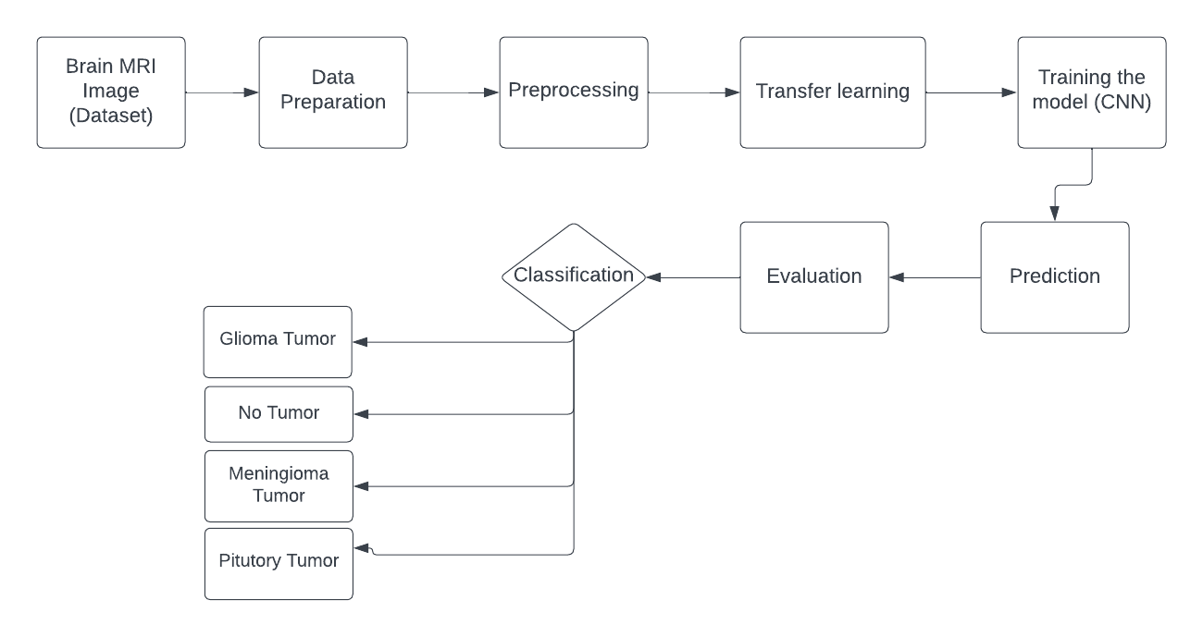
SYSTEM DIAGRAM / ARCHITECTURE:
Department of Computer Science & Engineering, DSCE

Slide 5
MODULES:
Importing all the Necessary Libraries
Data Preparation
Preprocessing
Transfer Learning
Training The Model
Prediction
Evaluation / Classification
Department of Computer Science & Engineering, DSCE

Slide 6
Modules Descriptions:
Importing Libraries : Following libraries were imported - numpy,matplotlib,tensorflow,sklearn,pandas and the required libraries.
Data Preperation : Appending all the images from the directories into a Python list and then converting them into numpy arrays after resizing it.
Preprocessing : Dividing the dataset into Training and Testing sets and performing One Hot Encoding on the labels after converting it into numerical values.
Transfer learning : Transfer learning is an amazing way to speed up deep learning training. It helps solve complex problems with pre-defined data and models.
Here, we have reused EfficientNetB0 model which will use the weights from the ImageNet dataset.
We replaced the top/output layer of the predefined model and add our own layers namely, GlobalAveragePooling2D ,Dropout, Dense. (CNN layers)
Department of Computer Science & Engineering, DSCE

Slide 7
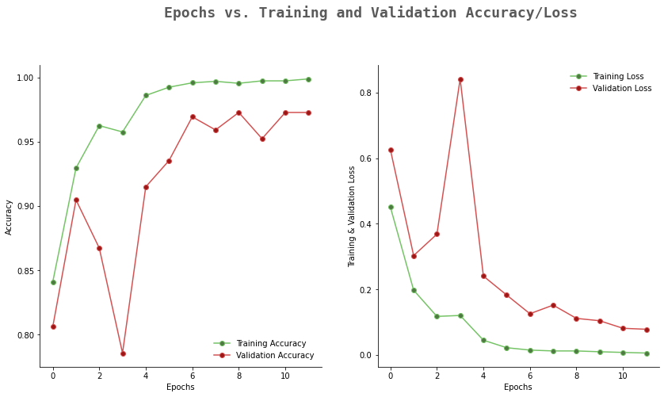
Modules Descriptions:
5. Training the model : Here the model is being trained and the results are as follows.
6. Prediction : We used argmax function as each row from the prediction array contains four values for the respective labels.
The maximum value which is in each row depicts the predicted output out of the 4 possible outcomes.
So with argmax, we found out the index associated with the predicted outcome.
Department of Computer Science & Engineering, DSCE

Slide 8
Modules Descriptions:
7. Evaluation : We have used confusion matrix for evaluation, and the evaluation metrics include precision, recall, f1-score and support
precision recall f1-score support
0 0.98 0.96 0.97 93
1 0.96 1.00 0.98 51
2 0.98 0.98 0.98 96
3 1.00 1.00 1.00 87
accuracy 0.98 327
macro avg 0.98 0.98 0.98 327
weighted avg 0.98 0.98 0.98 327
8. Classification : Classified the tumors as follows (One Hot Encoding) :
0 - Glioma Tumor
1 - No Tumor
2 - Meningioma Tumor
3 - Pituitary Tumor
Department of Computer Science & Engineering, DSCE

Slide 9
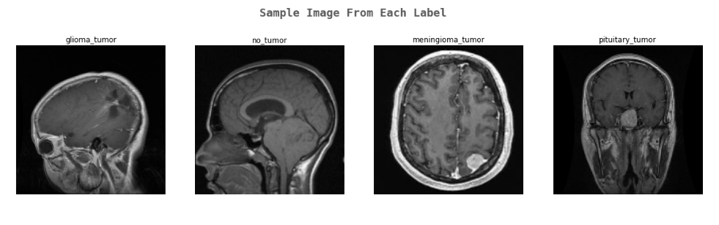
INPUT DATA:
The dataset used consists of the following images :
Department of Computer Science & Engineering, DSCE

Slide 10
ALGORITHM:
Firstly, we import necessary libraries which includes: numpy, pandas, seaborn, cv2, tensorflow, sklearn,etc.
We start off by appending all the images from the directories into a Python list and then converting them into numpy arrays after resizing it.
Then, divide the dataset into Training and Testing sets and perform One Hot Encoding on the labels after converting it into numerical values.
Department of Computer Science & Engineering, DSCE

Slide 11
ALGORITHM :
Deep convolutional neural network models may take days or even weeks to train on very large datasets, hence we will be using be using the EfficientNetB0 model(pre -trained) which will use the weights from the ImageNet dataset.
We have added our own output layers, these include - GlobalAveragePooling2D, Dropout, Dense.
Softmax Activation function is used.
We finally compile our model, and also use callbacks to fix bugs quickly and help build better modules. We will be using TensorBoard, ModelCheckpoint and ReduceLROnPlateau callback functions.

Slide 12
ALGORITHM :
The training takes a lot of time! ~ 1 hours.
We have used argmax function for prediction, as it finds out the index associated with the predicted outcome.
We have used the Confusion Matrix for evaluation of our model.
In the classification step, we classified the tumors into 4 parts, namely
0 - Glioma Tumor
1 - No Tumor
2 - Meningioma Tumor
3 - Pituitary Tumor

Slide 13
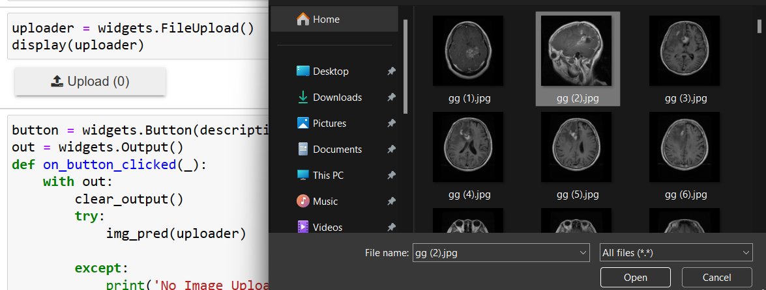
OUTPUT :
Fig 1. Uploading an Image of Brain Tumor (Glioma Tumor) for Prediction
Department of Computer Science & Engineering, DSCE

Slide 14
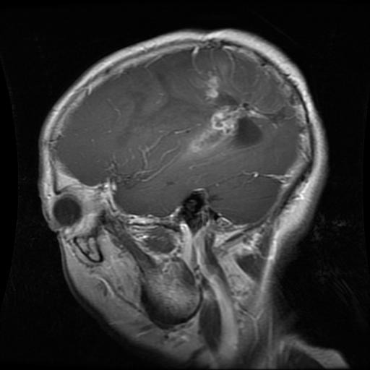
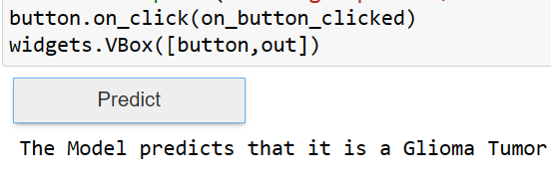
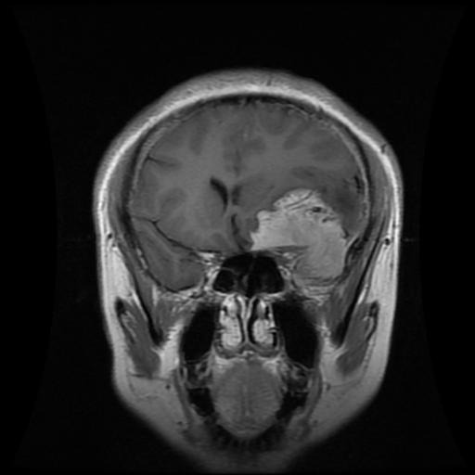
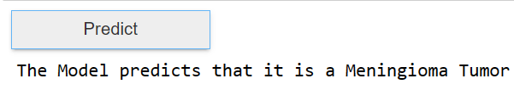
OUTPUT :
Fig 2. Prediction Results for the MRI image uploaded (Glioma Tumor)
Fig 3. Prediction Results for the MRI image uploaded (Meningioma Tumor)
Department of Computer Science & Engineering, DSCE

Slide 15
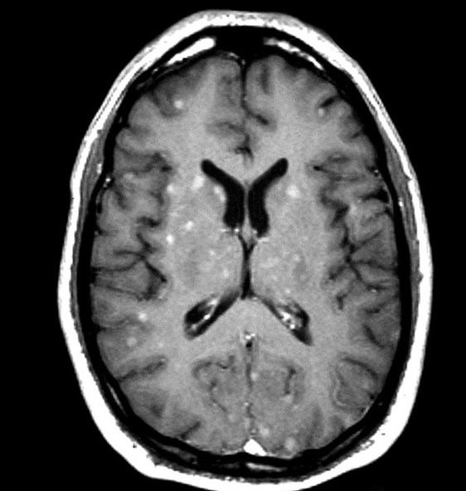
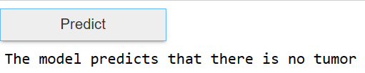
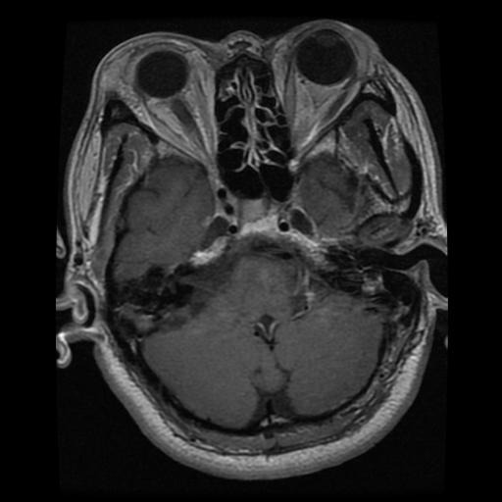
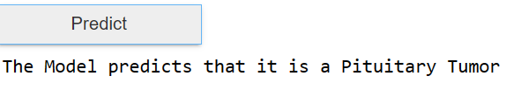
OUTPUT :
Fig 4. Prediction Results for the MRI image uploaded (NO Tumor)
Fig 5. Prediction Results for the MRI image uploaded (Pituitary Tumor)
Department of Computer Science & Engineering, DSCE

Slide 16
Co-Guide Meet Details :
Implementation done till now was explained to the co-guide.
Co-guide gave a good review on the project implementation and asked us to proceed with the full-stack implementation.
Co-guide gave us an insight about web-app integration.
The technologies suggested for Full stack implementation-
a) Frontend - React.js / HTML / CSS
b) Backend - Django / Flask (as Python is used)
Co-guide suggested us to give an update once full-stack implementation is completed and asked to reach out to him in case of any query.
Department of Computer Science & Engineering, DSCE

Slide 17
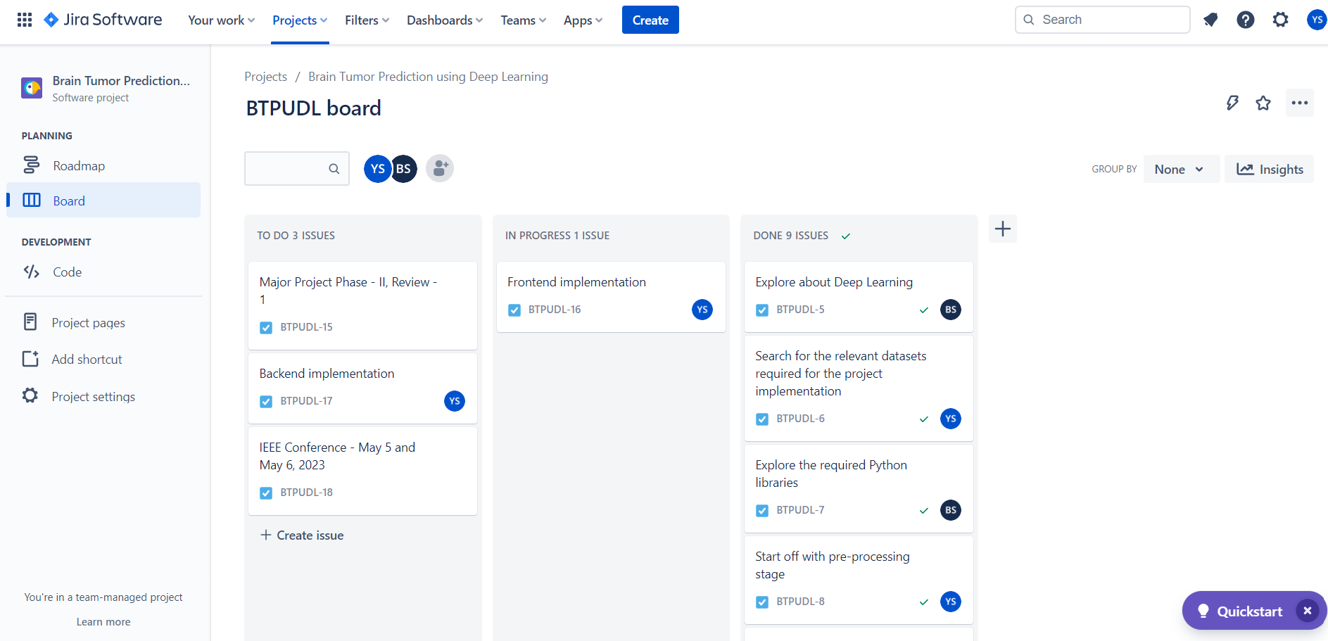
PROJECT TOOL SNAPSHOT:
Department of Computer Science & Engineering, DSCE

Slide 18
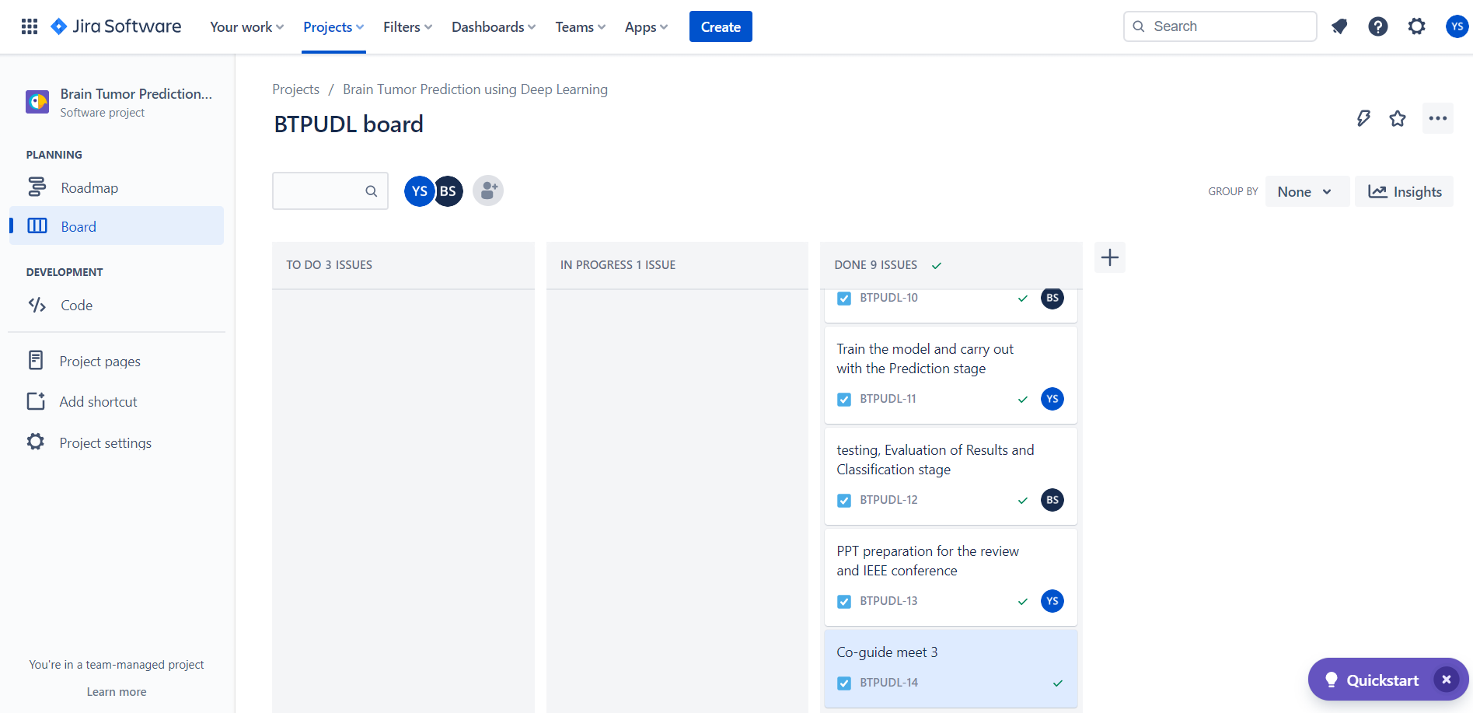
PROJECT TOOL SNAPSHOT:
Department of Computer Science & Engineering, DSCE

Slide 19
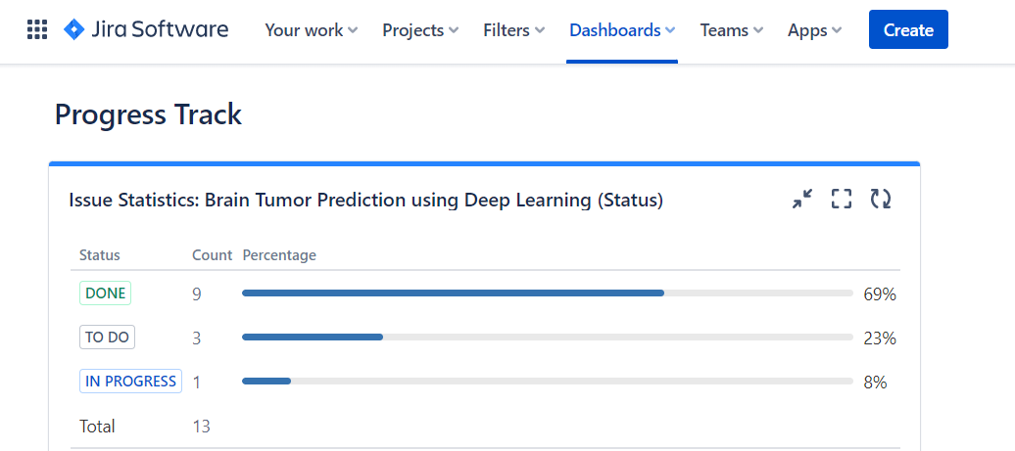
PROJECT TOOL SNAPSHOT:
Department of Computer Science & Engineering, DSCE

Slide 20
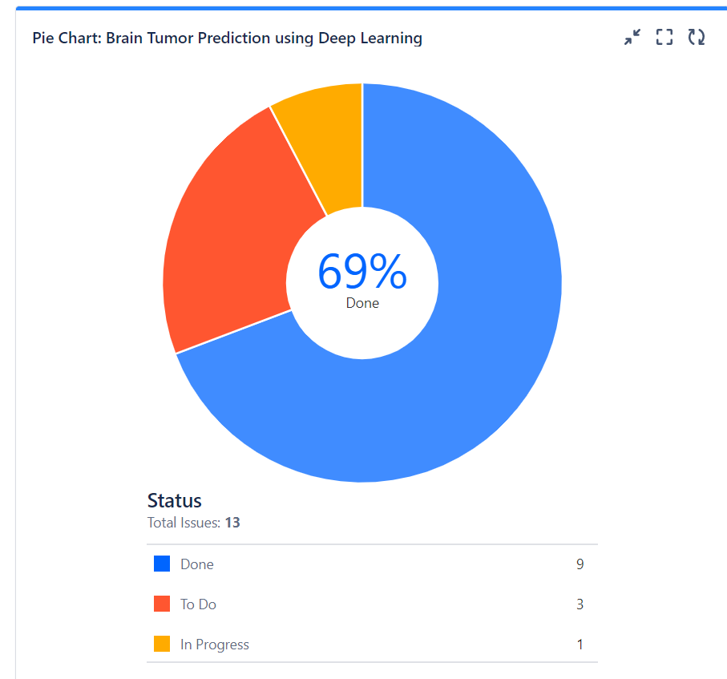
Department of Computer Science & Engineering, DSCE

Slide 21
THANK YOU !
Department of Computer Science & Engineering, DSCE

